Slide 1
Overflow2
Overflow Detector 2
S
S₂
S₁
S₀
A | B | S | Overflow 1
0 | 0 | 0
0 | 0 | 1
0 | 1 | 0
0 | 1 | 1
1 | 0 | 0
1 | 0 | 1
1 | 1 | 0
1 | 1 | 1
C_{in} | C_{out} | Overflow 2
0 | 0
0 | 1
1 | 0
1 | 1
Full Adder
Full Adder
C₂
Full Adder
C₁
Full Adder
C₀
C_{out}
C_{in}
c
Overflow1
Overflow Detector 1
A₂ B₂
A₁ B₁
A₀ B₀
A B
A | B | S | Overflow 1
0 | 0 | 0 | 0
0 | 0 | 1 | 1
0 | 1 | 0 | 0
0 | 1 | 1 | 0
1 | 0 | 0 | 0
1 | 0 | 1 | 0
1 | 1 | 0 | 1
1 | 1 | 1 | 0
C_{in} | C_{out} | Overflow 2
0 | 0 | 0
0 | 1 | 1
1 | 0 | 1
1 | 1 | 0

Slide 2
HW 21.1
HW 21.2
000
Q₂ | Q₁ | Q₀ | N₂ | N₁ | N₀
0 | 0 | 0 | 0 | 1 | 1
0 | 0 | 1 | X | X | X
0 | 1 | 0 | X | X | X
0 | 1 | 1 | 1 | 1 | 0
1 | 0 | 0 | X | X | X
1 | 0 | 1 | X | X | X
1 | 1 | 0 | 0 | 0 | 0
1 | 1 | 1 | X | X | X
111
Q₂ | Q₁ | Q₀ | N₂ | N₁ | N₀
0 | 0 | 0 | 1 | 1 | 1
0 | 0 | 1 | 0 | 0 | 0
0 | 1 | 0 | 0 | 0 | 1
0 | 1 | 1 | 0 | 1 | 0
1 | 0 | 0 | 0 | 1 | 1
1 | 0 | 1 | 1 | 0 | 0
1 | 1 | 0 | 1 | 0 | 1
1 | 1 | 1 | 1 | 1 | 0
000
110
Z
Z
001
101
110
011
010
Z
100
011
INC’DEC’
HW 21.4
INC
INC’DEC’
INC
CLR
111
INC’DEC’
000
110
INC
Z
INC
INC’DEC’
001
INC’ DEC
101
INC’DEC’
INC
Z
INC
010
100
INC’DEC’
011
INC’DEC’
INC
INC
INC’DEC’

Slide 3
Part A
module(
output logic[7:0] Q
input wire logic[7:0] A, B
input wire logic[1:0] ctrl);
always_comb begin
case(ctrl)
0: Q = A;
1: Q = A+B;
2: Q = A-B;
3: Q = ~A;
default: Q = ‘X;
endcase
end
endmodule
Part B
module(
output logic[9:0] Q
input wire logic[9:0] A, B, C);
always_comb begin
if(A > B)
if (B > C)
Q = A;
else if (C > A)
Q = C;
else if (B > C)
Q = B;
else
Q = C;
end
endmodule

Slide 4
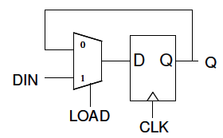
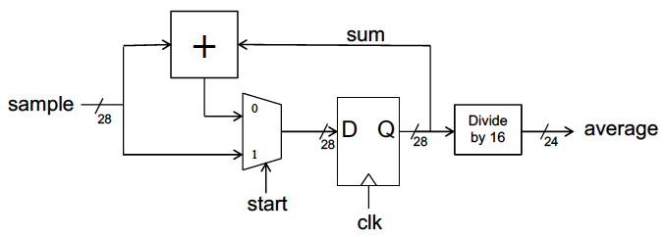
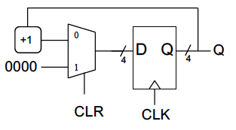
HW 22
B’
A’B’
Fig. 16.4
13 ns
EE
Even
5 ns
AB
A’B
B
Z
AB
A’B
B
AB’
A’B’
OO
EO
A’B’
5 ns
AB’
AB’
3 ns
Odd
A’B
AB’
AB
A’B
AB
B’
OE
Fig. 16.11
Fig. 16。6
17 ns
A’B’
4 ns
5 ns
14 ns
5 ns
3 ns
3 ns

Slide 5
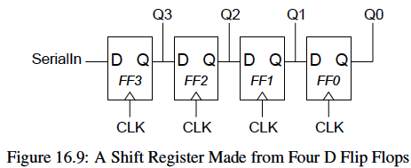
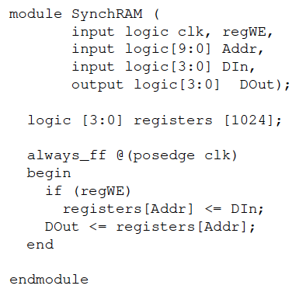
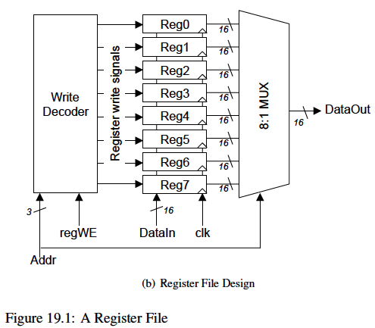
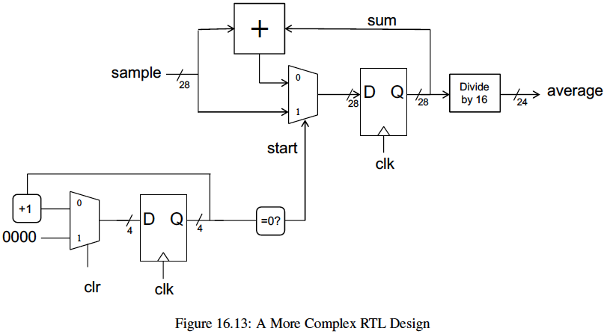
This SRAM. MUX is the IFL.
5 ns
3 ns
Decoder: 4ns
MUX: 5ns
Setup: 5ns
41ns
28ns
AND: 2ns
4+2+5+5=16ns
5ns
5ns
3ns
4+5+5+3=17ns
11ns
3+1+5+5=14ns

Slide 6
always_ff @(posedge clk)
if (A)
begin
if (B) Q <= 0;
end
else if (C)
Q <= Q + 1;
else
Q <= Q – 1;
always_ff @(posedge clk)
if (!S[0])
begin
if (!S[1]) Q <= 0;
end
else if (!S[1])
Q <= Q + 1;
else
Q <= Q – 1;
0
00
01
10
11
Q + 1
4
D Q
4
Q
Q
4
4
Q - 1
4
4
2
S
clk
A.
D.
A
A
E
E
B
B
always_comb
begin
C = ~(A&B);
D = C & A;
E = D & B;
end
B.
E.
A
E
A
B
B
E
C.
F.
A
A
B
B
E
E

Slide 7
INC’
00
Z
INC
INC
INC’
01
Z
10
INC’
INC
INC/Y
11
INC’
N1 = Inc’ Q₁ + Inc Q₀’
N2 = Inc’ Q₀ + Inc Q₁
Z = Q₁’
Y = Inc Q₀ Q₁

Slide 8
Xin
00
Xin’
Xin
11
Z
01
Xin
Xin’
10
Xin’
1100110
1000010
0000101
1000100
0101010
1100010
0100000
1100001
N1 = Xin’ Q₁’Q₀ + Xin Q₁ Q₀’
N2 = Xin’ Q₀’ + Xin Q₁Q₀’
Z = Q₀ Q₁

Slide 9
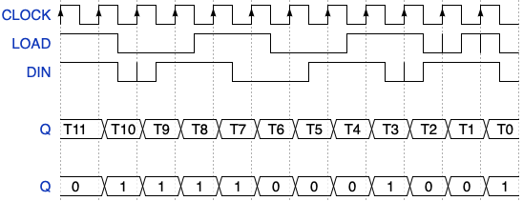
{signal: [
{name: "CLOCK", wave: "P..........."},
{name: "LOAD", wave: "hplnhplnhpnp" },
{name: "DIN", wave: "hpnhplnhpnhp" },
{},
{name: "Q", wave: "============", data:["T11","T10","T9","T8","T7","T6","T5","T4","T3","T2","T1","T0"]},
{},
{name: "Q", wave: "============", data:["0","1","1","1","1","0","0","0","1","0","0","1"]},
]}

Slide 10
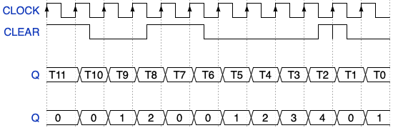
{signal: [
{name: "CLOCK", wave: "P..........."},
{name: "CLEAR", wave: "hplnhpl..npl" },
{},
{name: "Q", wave: "============", data:["T11","T10","T9","T8","T7","T6","T5","T4","T3","T2","T1","T0"]},
{},
{name: "Q", wave: "============", data:["0","0","1","2","0","0","1","2","3","4","0","1"]},
]}

Slide 11
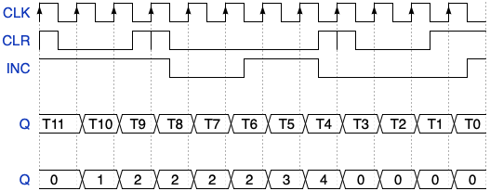
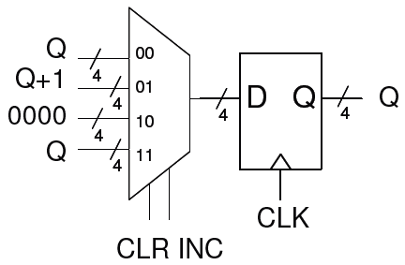
{signal: [
{name: "CLK", wave: "P..........."},
{name: "CLR", wave: "plnpl..nplnh" },
{name: "INC", wave: "h..plnhpl..n" },
{},
{name: "Q", wave: "============", data:["T11","T10","T9","T8","T7","T6","T5","T4","T3","T2","T1","T0"]},
{},
{name: "Q", wave: "============", data:["0","1","2","2","2","2","3","4","0","0","0","0"]},
]}

Slide 12
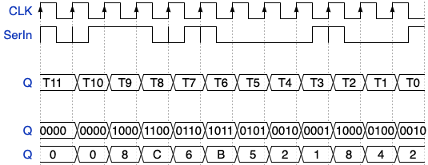
{signal: [
{name: "CLK", wave: "P..........."},
{name: "SerIn", wave: "pnhpnpl.npln" },
{},
{name: "Q", wave: "============", data:["T11","T10","T9","T8","T7","T6","T5","T4","T3","T2","T1","T0"]},
{},
{name: "Q", wave: "============", data:["0000","0000","1000","1100","0110","1011","0101","0010","0001","1000","0100","0010"]},
{name: "Q", wave: "============", data:["0","0","8","C","6","B","5","2","1","8","4","2"]},
]}
Q[3]
Q[2]
Q[1]
Q[0]
SerIn
D Q
D Q
D Q
D Q
CLK

Slide 13
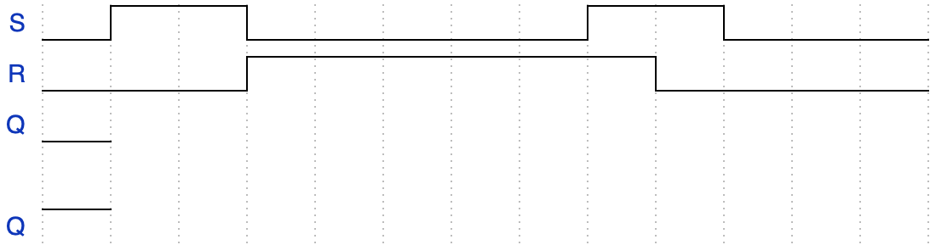
{signal: [
{name: 'S', wave: 'lh.l....h.l..'},
{name: 'R', wave: 'l..h.....l...'},
{name: 'Q', wave: 'l'},
{},
{name: 'Q', wave: 'h'}
]}
HW 15.1
HW 15.2
2ns
2ns
2ns
2ns
2ns
2ns

Slide 14
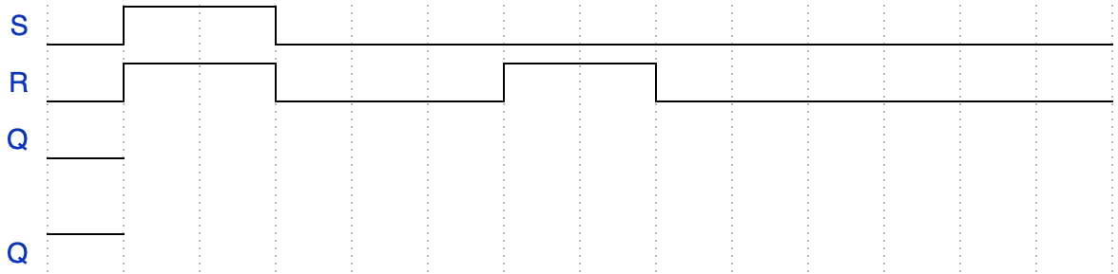
{signal: [
{name: 'S', wave: 'lh.l..........'},
{name: 'R', wave: 'lh.l..h.l.....'},
{name: 'Q', wave: 'l'},
{},
{name: 'Q', wave: 'h'}
]}
HW 15.3
5ns
10ns
5ns
10ns
14ns
17ns
2ns
2ns
2ns
2ns
2ns
2ns
2ns
7ns
10ns
2ns
2ns
2ns
2ns
2ns
2ns
2ns
2ns
HW 15.4
Function srLatch(int S, int R, int Q) {
if (S == 0 && R == 1)
return 0;
if (S == 1 && R == 0)
return 1;
else
return Q;
}

Slide 15
module mux21(
output logic out, // the output input wire logic I0, // the first input input wire logic I1, // the second input input wire logic s // the select signal );
module mux41(
output logic out, // the output input wire logic I0, // the first input input wire logic I1, // the second input input wire logic I2, // the third input input wire logic I3, // the fourth input input wire logic s1, // the MSB of the select signal input wire logic s0 // the LSB of the select signal );

Slide 16
module mux81(
output logic out, // the output input wire logic[7:0] in, // the eight inputs input wire logic[2:0] s); // the select signals
logic tmp1, tmp2;
mux21 M0(out, tmp1, tmp2, s[0]);
mux41 M1(tmp1, A, B, C, D, s[2], s[1]);
mux41 M2(tmp2, E, F, G, H, s[2], s[1]);
Endmodule

Slide 17
module mux41 (
input wire logic I0, I1, I2, I3, S0, S1,
output logic Out);
logic S0_not, S1_not;
logic and_I0, and_I1, and_I2, and_I3;
not(S0_not, S0);
not(S1_not, S1);
and(and_I0, I0, S0_not, S1_not);
……
or(Out, and_I0, and_I1, and_I2, and_I3);
endmodule
I0
I1
I2
I3
S0
S1
and_I0
and_I1
and_I2
and_I3
S0_not
S1_not

Slide 18
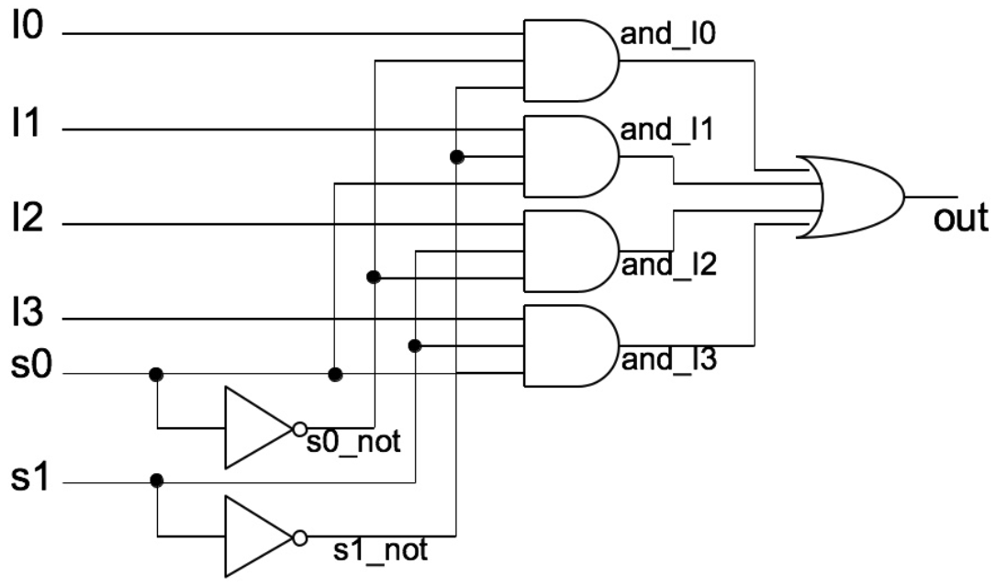
module mux41 (
input wire logic I0, I1, I2, I3, S0, S1,
output logic Out);
logic S0_not, S1_not;
logic and_I0, and_I1, and_I2, and_I3;
not(S0_not, S0);
not(S1_not, S1);
and(and_I0, I0, S0_not, S1_not);
……
or(Out, and_I0, and_I1, and_I2, and_I3);
endmodule

Slide 20
In Out
0
In out
a
p1
A
p3
q
F
abar
B
b
p2
bbar

Slide 21
A
B
C
C
In out
In Out
1
In Out
0
D
E
0 out
1 out
p2
bbar

Slide 22
A
B
C
In out
In Out
1
In Out
0
A
B
C
In out
p2
bbar

Slide 23
A
B
f
C
A
B
B
C
D
A B C D
F
A
B
B
C
D
A
B
B
C
D
A
B
B
C
D
A
B
B
C
D
F
F
F
F

Slide 24
A B C
D E F

Slide 25
A B C
D E F

Slide 26
A
B
C’
B’
A
B
C
F
F
A
E
C=0
D
F

Slide 27
A
AB
A
 | 0 | 1
00 |  | 1
01
11
10 | 1 | 1
 | 00 | 01 | 11 | 10
00 | 1 | 1 | 0 | 1
01 | 1 | 1 | 1 | 1
11 | 0 | 1 | 0 | 1
10 | 1 | 1 | 0 | 1
 | 0 | 1
00
01
11
10
BC
CD
BC
AB
AB
AB
 | 00 | 01 | 11 | 10
00
01
11
10
 | 00 | 01 | 11 | 10
00 | 1 | 1 | 1 | 1
01 | 0 | 0 | 1 | 1
11 | 0 | 1 | 1 | 0
10 | 1 | 1 | 1 | 1
 | 00 | 01 | 11 | 10
00 | 1 | 0 | 0 | 1
01 | 0 | 1 | 1 | 0
11 | 0 | 1 | 1 | 0
10 | 1 | 1 | 1 | 1
AB
 | 00 | 01 | 11 | 10
00 | 1 | 0 | 0 | 1
01 | 0 | 1 | 1 | 0
11 | 0 | 1 | 1 | 0
10 | 1 | 1 | 1 | 1
CD
CD
CD
CD

Slide 28
AB
AB
 | 00 | 01 | 11 | 10
00 | 1 | 1 | 0 | 1
01 | 1 | 1 | 0 | 1
11 | 1 | 1 | 1 | 1
10 | 1 | 1 | 0 | 0
 | 00 | 01 | 11 | 10
00 | 1 | 1 | 0 | 1
01 | 1 | 1 | 0 | 1
11 | 1 | 1 | 1 | 1
10 | 1 | 1 | 0 | 0
AB
 | 00 | 01 | 11 | 10
00 | 1 | 1 | 0 | 1
01 | 1 | 1 | 0 | 1
11 | 1 | 1 | 1 | 1
10 | 1 | 1 | 0 | 0
CD
CD
CD
AB
 | 00 | 01 | 11 | 10
00 | 1 | x | 0 | 0
01 | 1 | 1 | 1 | x
11 | 0 | 1 | 0 | 0
10 | x | 1 | x | 1
AB
AB
 | 00 | 01 | 11 | 10
00 | 1 | x | x | 0
01 | 1 | 1 | 1 | x
11 | 0 | 1 | 0 | 0
10 | x | 1 | x | 1
 | 00 | 01 | 11 | 10
00 | 1 | x | x | 0
01 | 1 | 1 | 1 | x
11 | 0 | 1 | 0 | 0
10 | x | 1 | x | 1
AB
 | 00 | 01 | 11 | 10
00 | 1 | x | x | 0
01 | 1 | 1 | 1 | x
11 | 0 | 1 | 0 | 0
10 | x | 1 | x | 1
CD
CD
CD
CD

Slide 29
AB
 | 00 | 01 | 11 | 10
00 | 1 | 1 | 1 | 0
01 | 1 | 1 | 0 | 0
11 | 1 | 0 | 0 | 1
10 | 1 | 1 | 1 | 1
CD

Slide 30
AB
 | 00 | 01 | 11 | 10
00 | 1 | x | x | 0
01 | 1 | 1 | 1 | x
11 | 0 | 1 | 0 | 0
10 | x | 1 | x | 1
AB
 | 00 | 01 | 11 | 10
00 | 1 | x | x | 0
01 | 1 | 1 | 1 | x
11 | 0 | 1 | 0 | 0
10 | x | 1 | x | 1
CD
CD
A’
C’
D’
B
C’
D
A
C
A’
C’
D’
AB
 | 00 | 01 | 11 | 10
00 | 1 | 1 | 0 | x
01 | x | 1 | 0 | x
11 | 1 | 1 | 0 | 0
10 | 1 | 1 | 0 | x
AB
 | 00 | 01 | 11 | 10
00 | 1 | 1 | 0 | 0
01 | 0 | 1 | 1 | 0
11 | 0 | 0 | 1 | 1
10 | 0 | 0 | 1 | 1
CD
CD
A’
B
C’
B
C’
D
A
B
D
A
C

Slide 31
In0
In1
In2
In3
In4
In5
In6
In7
000
001
010
011
100
101
110
111
Out
00
01
10
11
00
01
10
11
Out
Out
In0
In1
In2
In3
In4
In5
In6
In7
In0
In1
In2
In3
In4
In5
In6
In7
S₂S₁S₀
00
01
10
11
00
01
10
11
00
01
10
11
Out
Out
Out
00
01
10
11
00
01
10
11
Out
Out
0
1
Out
S₂S₁S₀
S₂S₁S₀

Slide 32
In0
In1
In2
In3
In4
In5
In6
In7
000
001
010
011
100
101
110
111
Out
00
01
10
11
00
01
10
11
Out
Out
In0
In1
In2
In3
In4
In5
In6
In7
In0
In1
In2
In3
In4
In5
In6
In7
S₂S₁S₀
00
01
10
11
00
01
10
11
00
01
10
11
Out
Out
Out
00
01
10
11
00
01
10
11
Out
Out
0
1
Out
S₂S₁S₀
S₂S₁S₀

Slide 33
AB
AB
 | 00 | 01 | 11 | 10
00 | 1 | 0 | 0 | 0
01 | 1 | 1 | 1 | 1
11 | 1 | 0 | 0 | 1
10 | 1 | 0 | 0 | 0
 | 00 | 01 | 11 | 10
00 | 1 | 0 | 0 | 0
01 | 1 | 1 | 1 | 1
11 | 1 | 0 | 0 | 1
10 | 1 | 0 | 0 | 0
CD
CD
B’ + C’D
0
1
Out
C’D+B’D
A
B’
00
01
10
11
B’ + C’
Out
0
AB
B’ + C’
 | 00 | 01 | 11 | 10
00 | 1 | 0 | 0 | 0
01 | 1 | 1 | 1 | 1
11 | 1 | 0 | 0 | 1
10 | 1 | 0 | 0 | 0
CD
A D
AB
 | 00 | 01 | 11 | 10
00 | 1 | 0 | 0 | 0
01 | 1 | 1 | 1 | 1
11 | 1 | 0 | 0 | 1
10 | 1 | 0 | 0 | 0
A’B’
0
1
Out
CD
C’+B’
D

Slide 34
A’B’C’D’
A’B’C’D
A’B’CD’
A’B’CD
A’BC’D’
A’BC’D
A’BCD’
A’BCD
AB’C’D’
AB’C’D
AB’CD’
AB’CD
ABC’D’
ABC’D
ABCD’
ABCD
A’B’C’D’
A’B’C’D
A’B’CD’
A’B’CD
A’BC’D’
A’BC’D
A’BCD’
A’BCD
AB’C’D’
AB’C’D
AB’CD’
AB’CD
ABC’D’
ABC’D
ABCD’
ABCD
A
B
C
D
A
B
C
D
4:16 Decoder
4:16 Decoder

Slide 35
In0
In1
In2
In3
In4
In5
In6
In7
3:8 Decoder
S₂S₁S₀

Slide 36
A
N1
F
B
N2
A
B
A’
B’
N1
N2
F no delay
F

Slide 37
C
D
D
E
C
Q
F
G
B
A’
Q’
A
B
CLK
C
D
E’
D
D Q
Q
CLK

Slide 38
sum
sample
+
0
1
D Q
28
Q
4
28
24
(MSB’s)
init
CLK
+
D Q
4
4
4
cnt
CLK

Slide 39
module upCnt #(WID=4)(
input logic clk, clr, inc,
output logic[WID-1:0] cnt
);
always_ff @(posedge clk)
if (？)
cnt <= 0;
else if (？)
cnt <= cnt + 1;
endmodule
cnt
00 01
10
11
cnt+1
4
D Q
0
4
cnt
4
4
cnt
4
4
2
clr inc
clk
!clr && !inc
!clr && inc
clr && !inc
clr && inc

Slide 40
Q₂ | Q₁ | Q₀ | N₂ | N₁ | N₀
0 | 0 | 0
0 | 0 | 1
0 | 1 | 0
0 | 1 | 1
1 | 0 | 0
1 | 0 | 1
1 | 1 | 0
1 | 1 | 1
Q₂ | Q₁ | Q₀ | N₂ | N₁ | N₀
0 | 0 | 0 | 0 | 1 | 0
0 | 0 | 1 | x | x | x
0 | 1 | 0 | 1 | 0 | 0
0 | 1 | 1 | x | x | x
1 | 0 | 0 | 1 | 1 | 0
1 | 0 | 1 | x | x | x
1 | 1 | 0 | 0 | 0 | 0
1 | 1 | 1 | x | x | x
 | 0 | 1
00 | 0 | 1
01 | x | x
11 | x | x
10 | 1 | 0
 | 0 | 1
00 | 1 | 1
01 | x | x
11 | x | x
10 | 0 | 0
 | 0 | 1
00 | 0 | 0
01 | x | x
11 | x | x
10 | 0 | 0
Q₁Q₀
Q₂
Q₂
Q₂
Q₁Q₀
Q₁Q₀
Q₂
Q₁
Q₀
D
D
D
Q₂’
Q₁’
Q₀’
Q
CLK
CLK
CLK
Q
Q
Q₂
Q₁
Q
N0=0
Q₀
D
D
D
D
D
CLK
CLK
CLK
Q’
Q’
Q₂’
Q₁’
Q₀’
CLK
CLK
CLK
CLK
CLK
CLK
CLK
CLK
CLK
CLK
Q₂ | Q₁ | Q₀ | N₂ | N₁ | N₀
0 | 0 | 0 | 0 | 0 | 1
0 | 0 | 1 | 1 | 0 | 0
0 | 1 | 0 | 1 | 0 | 1
0 | 1 | 1 | x | x | x
1 | 0 | 0 | 0 | 1 | 0
1 | 0 | 1 | 1 | 1 | 0
1 | 1 | 0 | 0 | 0 | 0
1 | 1 | 1 | x | x | x
 | 0 | 1
00 | 0 | 0
01 | 1 | 1
11 | x | x
10 | 1 | 0
 | 0 | 1
00 | 0 | 1
01 | 0 | 1
11 | x | x
10 | 0 | 0
 | 0 | 1
00 | 1 | 0
01 | 0 | 0
11 | x | x
10 | 1 | 0
Q₂ | Q₁ | Q₀ | N₂ | N₁ | N₀
0 | 0 | 0
0 | 0 | 1
0 | 1 | 0
0 | 1 | 1
1 | 0 | 0
1 | 0 | 1
1 | 1 | 0
1 | 1 | 1
 | 0 | 1
00
01
11
10
 | 0 | 1
00
01
11
10
 | 0 | 1
00
01
11
10
Q₂
Q₂
Q₂
Q₂
Q₂
Q₂
Q₁Q₀
Q₁Q₀
Q₁Q₀
Q₁Q₀
Q₁Q₀
Q₁Q₀

Slide 41
Clr | Inc | Q₁ | Q₀ | N₁ | N₀
0 | 0 | 0 | 0 | 0 | 0
0 | 0 | 0 | 1 | 0 | 1
0 | 0 | 1 | 0 | 1 | 0
0 | 0 | 1 | 1 | 1 | 1
0 | 1 | 0 | 0 | 1 | 0
0 | 1 | 0 | 1 | 0 | 0
0 | 1 | 1 | 0 | 1 | 1
0 | 1 | 1 | 1 | 0 | 1
1 | 0 | 0 | 0 | 0 | 0
1 | 0 | 0 | 1 | 0 | 0
1 | 0 | 1 | 0 | 0 | 0
1 | 0 | 1 | 1 | 0 | 0
1 | 1 | 0 | 0 | 1 | 0
1 | 1 | 0 | 1 | 0 | 0
1 | 1 | 1 | 0 | 1 | 1
1 | 1 | 1 | 1 | 0 | 1
 | 00 | 01 | 11 | 10
00
01
11
10
 | 00 | 01 | 11 | 10
00 | 0 | 1 | 1 | 0
01 | 0 | 0 | 0 | 0
11 | 1 | 0 | 0 | 0
10 | 1 | 1 | 1 | 0
 | 00 | 01 | 11 | 10
00 | 0 | 0 | 0 | 0
01 | 1 | 0 | 0 | 0
11 | 1 | 1 | 1 | 0
10 | 0 | 1 | 1 | 0
Clr Inc
Clr Inc
Clr Inc
Clr Inc
 | 00 | 01 | 11 | 10
00 | 0 | 0 | 0 | 0
01 | 1 | 0 | 0 | 0
11 | 1 | 1 | 1 | 1
10 | 0 | 0 | 0 | 0
Q₁Q₀
Q₁Q₀
Q₁Q₀
Q₁Q₀
Inc’
Clr | Inc | Q₁ | Q₀ | N₁ | N₀ | Z
0 | 0 | 0 | 0 | 0 | 0 | 0
0 | 0 | 0 | 1 | 0 | 1 | 0
0 | 0 | 1 | 0 | 1 | 0 | 0
0 | 0 | 1 | 1 | 1 | 1 | 1
0 | 1 | 0 | 0 | 1 | 0 | 0
0 | 1 | 0 | 1 | 0 | 0 | 0
0 | 1 | 1 | 0 | 1 | 1 | 0
0 | 1 | 1 | 1 | 0 | 1 | 1
1 | 0 | 0 | 0 | 0 | 0 | 0
1 | 0 | 0 | 1 | 0 | 0 | 0
1 | 0 | 1 | 0 | 0 | 0 | 0
1 | 0 | 1 | 1 | 0 | 0 | 1
1 | 1 | 0 | 0 | 1 | 0 | 0
1 | 1 | 0 | 1 | 0 | 0 | 0
1 | 1 | 1 | 0 | 1 | 1 | 0
1 | 1 | 1 | 1 | 0 | 1 | 1
Clr’
Q₁
Q₁
D
Inc
Q₁’
CLK
Q₀’
CLK
Inc’
Clr’
Q₀
Q₀
D
Inc
Q₀’
CLK
Q₁
CLK

Slide 42
Inc | Q₁ | Q₀ | N₂ | N₁ | Y | Z
0 | 0 | 0 | 0 | 0 | 0 | 0
0 | 0 | 1 | 0 | 1 | 0 | 0
0 | 1 | 0 | 1 | 0 | 0 | 0
0 | 1 | 1 | 1 | 1 | 1 | 0
1 | 0 | 0 | 0 | 1 | 0 | 0
1 | 0 | 1 | 1 | 0 | 0 | 1
1 | 1 | 0 | 1 | 1 | 0 | 1
1 | 1 | 1 | 0 | 0 | 1 | 0
Clock
Inc
Q₁Q₀
Y
Z
00
01
10
11
00
01
10
11
Clr | Inc | Q₁ | Q₀ | N₁ | N₀
0 | 0 | 0 | 0 | x | x
0 | 0 | 0 | 1 | x | x
0 | 0 | 1 | 0 | x | x
0 | 0 | 1 | 1 | x | x
0 | 1 | 0 | 0 | 0 | 1
0 | 1 | 0 | 1 | 1 | 1
0 | 1 | 1 | 0 | 0 | 0
0 | 1 | 1 | 1 | 1 | 0
1 | 0 | 0 | 0 | 0 | 0
1 | 0 | 0 | 1 | 0 | 0
1 | 0 | 1 | 0 | 0 | 0
1 | 0 | 1 | 1 | 0 | 0
1 | 1 | 0 | 0 | 0 | 0
1 | 1 | 0 | 1 | 0 | 0
1 | 1 | 1 | 0 | 0 | 0
1 | 1 | 1 | 1 | 0 | 0
 | 00 | 01 | 11 | 10
00
01
11
10
 | 00 | 01 | 11 | 10
00 | x | 0 | 0 | 0
01 | x | 1 | 0 | 0
11 | x | 1 | 0 | 0
10 | x | 0 | 0 | 0
 | 00 | 01 | 11 | 10
00 | x | 1 | 0 | 0
01 | x | 1 | 0 | 0
11 | x | 0 | 0 | 0
10 | x | 0 | 0 | 0
Clr Inc
Clr Inc
Clr Inc
Q₁Q₀
Q₁Q₀
Q₁Q₀

Slide 43
x’
00
000
Z
Q₁ | Q₀ | N₁ | N₀
0 | 0 | 1 | 0
0 | 1 | 0 | 0
1 | 0 | 0 | 1
1 | 1 | x | x
Q₂ | Q₁ | Q₀ | N₂ | N₁ | N₀ | Z
0 | 0 | 0 | 0 | 0 | 1 | 0
0 | 0 | 1 | 0 | 1 | 1 | 1
0 | 1 | 0 | x | x | x | x
0 | 1 | 1 | 1 | 0 | 1 | 0
1 | 0 | 0 | x | x | x | x
1 | 0 | 1 | 1 | 1 | 1 | 0
1 | 1 | 0 | x | x | x | x
1 | 1 | 1 | 0 | 0 | 0 | 1
0001
x’
001
100
Z
x
000
01
10
1000
Z
0010
Z
111
001
Z
101
110
y
x
0100
Z
101
011
111
010
y’
011
Z
CLR+CLR’ ∙ INC’ ∙DEC’
000
Z
CLR+INC
000
CLR’∙INC
111
001
CLR’∙INC’ ∙DEC’
CLR’∙INC’ ∙DEC’
111
CLR’∙INC’ ∙DEC
CLR+CLR’∙INC’ ∙DEC
001
CLR’∙INC
CLR
CLR
CLR’∙INC
110
010
CLR’∙INC’ ∙DEC
CLR’∙INC’ ∙DEC
110
010
CLR’∙INC’ ∙DEC’
CLR’∙INC’ ∙DEC’
CLR
CLR
CLR
CLR’∙INC’ ∙DEC
CLR’∙INC’ ∙DEC
CLR’∙INC
101
011
CLR’∙INC
101
011
100
CLR’∙INC’ ∙DEC
CLR’∙INC’ ∙DEC
CLR’∙INC’ ∙DEC’
100
CLR’∙INC’ ∙DEC’
CLR’∙INC
CLR’∙INC
CLR’∙INC’ ∙DEC’

Slide 44
 | 00 | 01 | 11 | 10
00 | 1 | 1
01 | 1 | 1 | 1 | 1
11 |  |  | 1 | 1
10 |  | 1 | 1
AB
CD
S₀
000
 | 0 | 1
00 | 0 (S₀) | 1 (S₅)
01 | 0 (S₁) | 1 (S₂)
11 | 0 (S₃) | x
10 | 0 (S₄) | x
Q₂
Q₁Q₀
X
S₅
S₁
X
100
001
S₄
010
S₃
S₂
X
Y
011
101
X

